Slide 1
Deep Learning for Image Recognition

Slide 2
TEAM
MANOGNA 2210030016
NAGARANI 2210030030
NANDINI 2210030048
AMRUTHA 2210030036

Slide 3
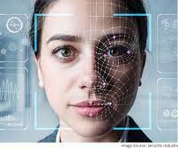
DEFINITON OF DEEP LEARNING-
Deep learning is a subset of machine learning that utilizes neural networks with multiple layers to understand and process data. It enables computers to learn from large amounts of labeled data and make decisions based on that data.

Slide 4
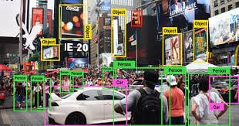
Image Recognition Overview
Image recognition allows machines to identify objects, people, entities, and other variables in images. It is a sub-category of computer vision technology that deals with recognizing patterns and regularities in the image data, and later classifying them into categories by interpreting image pixel patterns.

Slide 5
Diverse fields through several key mechanisms
Automated Object Detection and Classification
Medical Imaging Diagnosis
Autonomous Vehicles
Surveillance and Security
Agriculture and Precision Farming
Retail and Customer Experience
Natural Disaster Response
Environmental Monitoring
Industrial Automation
Document Analysis and OCR

Slide 6
Image Recognition Basics
Data Preparation: Discussing the importance of data preparation for image recognition, including tasks such as data cleaning, preprocessing, and augmentation to ensure the quality and diversity of the training data.
Training Process: Explaining the training process for deep learning models, including the use of labeled image datasets, backpropagation, and optimization techniques to train the models to recognize and classify images accurately.

Slide 7
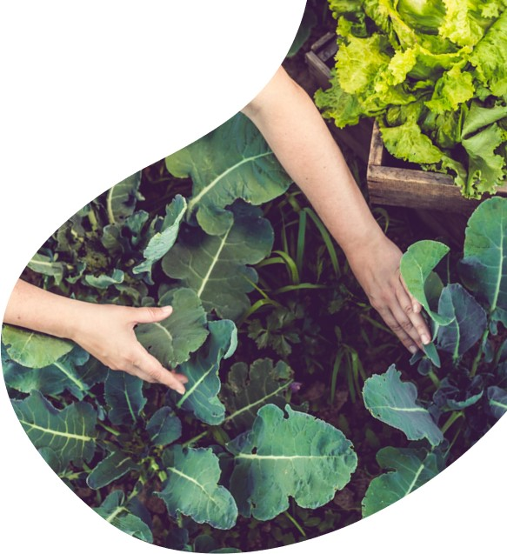
Dog Breed Classification
Built an app for predicting dog breed based on a dog photo and recommendation system for similar breeds
Used an ensemble of neural network models using Keras to predict 1 out of 120 dog breeds
Web scraped using Selenium for gathering the dog characteristics
Created a dog recommendation engine using cosine similarity of the dog characteristics
Used Streamlit library to build an interactive web app

Slide 8
thank you

